Slide 1
Guide For Online Lectures Using Zoom
Hassan Jaleel
Department of Electrical Engineering
Syed Babar Ali School of Science and Engineering
Lahore University of Management Sciences

Slide 2
Synchronous vs Asynchronous Lectures
Synchronous Lectures
Online lectures via Zoom/Google hangouts/Skype etc.
Pros: Interactive sessions
Cons: Requires access to high bandwidth internet connection
Asynchronous Lectures
Record lectures offline and upload on LMS
Pros: Does not require high bandwidth internet
Cons: Lacks active interaction with students during lecture
Synchronous + Asynchronous Lectures
Deliver online lectures via Zoom/Google hangouts/Skype etc
Record these online sessions
Upload the recorded lectures on LMS
Interactive lectures with the students who can join online
Students without access to high bandwidth internet can watch recorded lectures

Slide 3
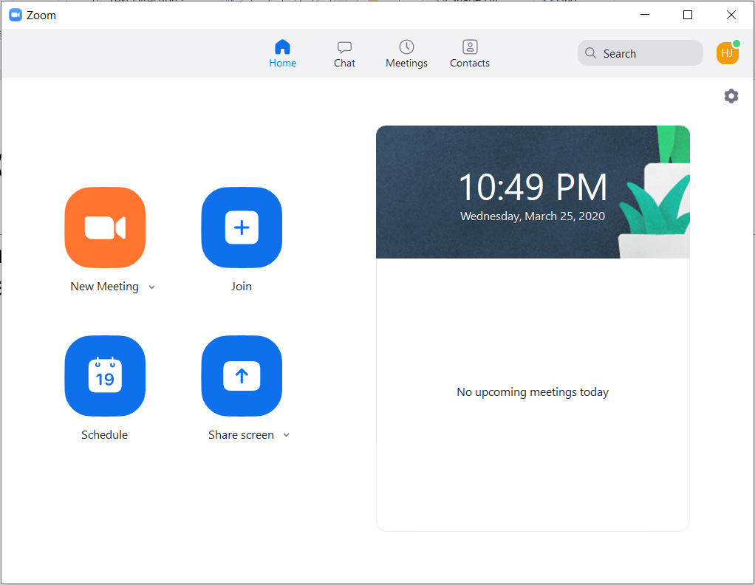
Quick Guide to Zoom
Download the desktop app from the link https://zoom.us/download and install it. Zoom can also be installed on cell phones and tablets.
Create a free account using your LUMS email address.
Sign in using your account. You will see the following window

Slide 4
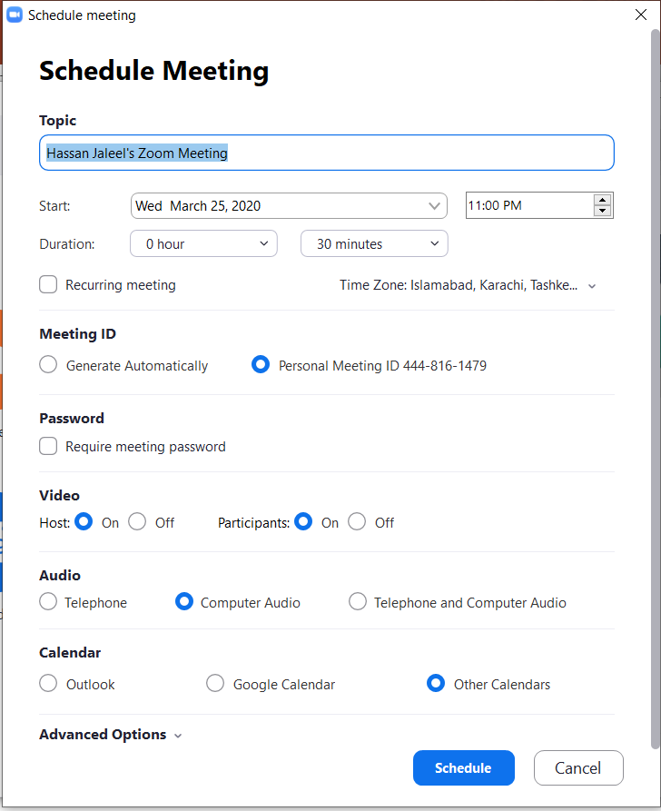
Meeting Setup
Meetings can be scheduled in advance
Click on Schedule tab
Fill in the details regarding the start time and
meeting duration. For Meeting ID you can
select Generate Automatically or
Personal Meeting ID. The Meeting ID is important
as it enables other participants to join in the meeting.
Press Schedule tab at the bottom once all
the required information is provided

Slide 5
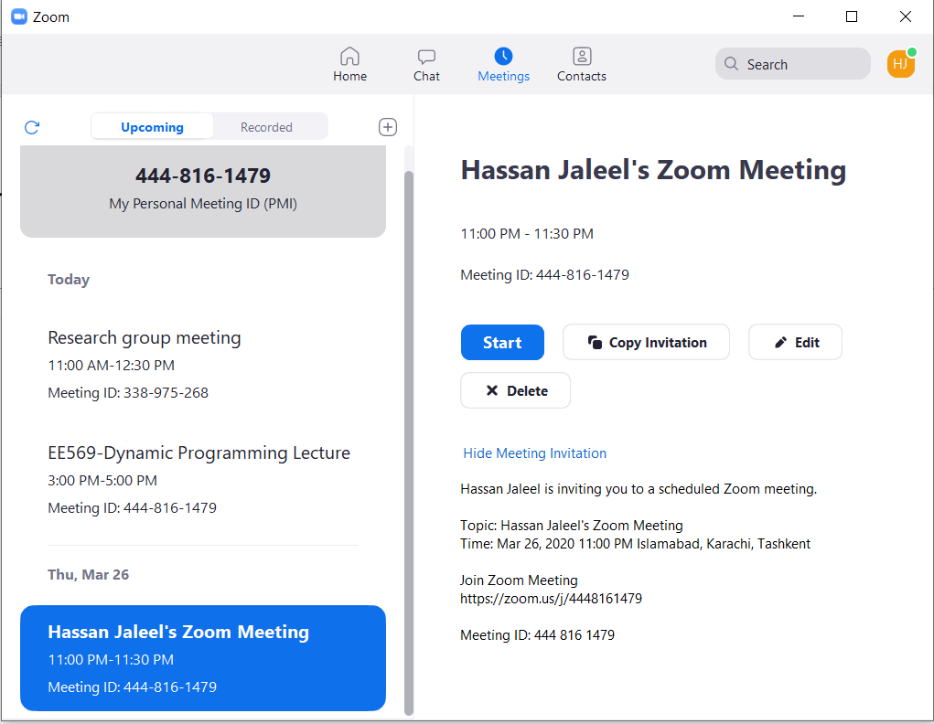
Meeting Setup
Once a meeting is setup, you can click on
the Meeting tab at the top to see your
scheduled meetings
To send an invitation to others one easy
easy way is to click on Copy Invitation
You can send the invitation to your
students through an email via LMS
The announcement contains zoom
meeting link as well as the Meeting ID

Slide 6
Zoom Meeting
The meeting window looks
like this
Each participant can
Mute/Unmute personal
audio
Start/Stop personal video
Raise hand to ask question
Share screen

Slide 7
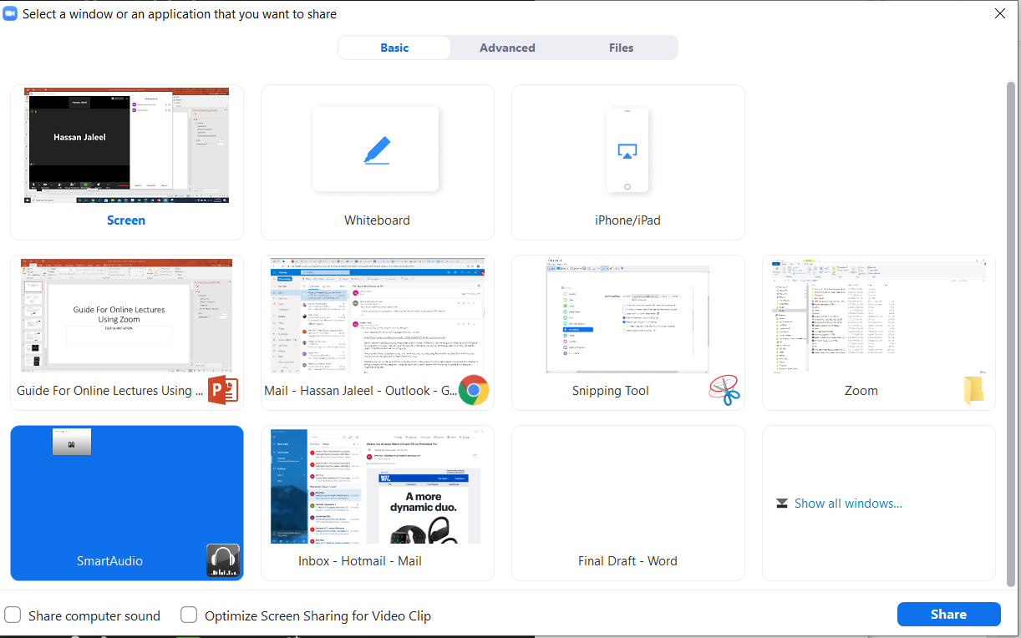
Screen Sharing
Each participant can share personal screen via Share Screen.
Share screen provides various options
You can either share your screen
or a particular application running
on your system.
There is a white board option as well
for scribbling
These options are useful for quickly
switching between different
applications like power point/pdf
and some software like MATLAB for
live demonstration.

Slide 8
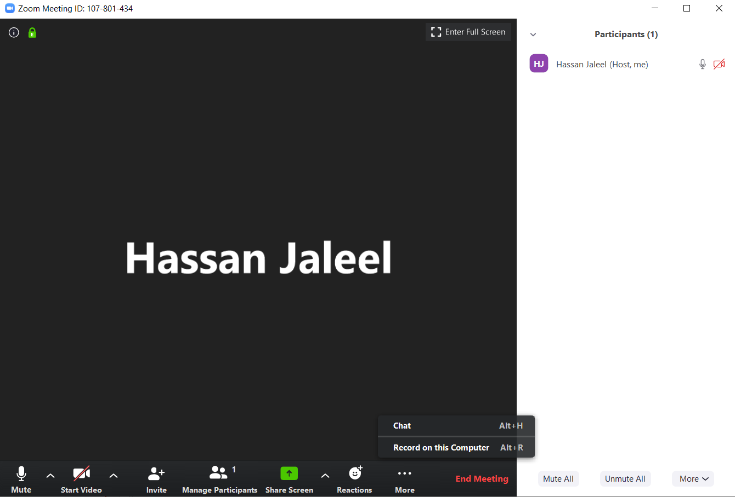
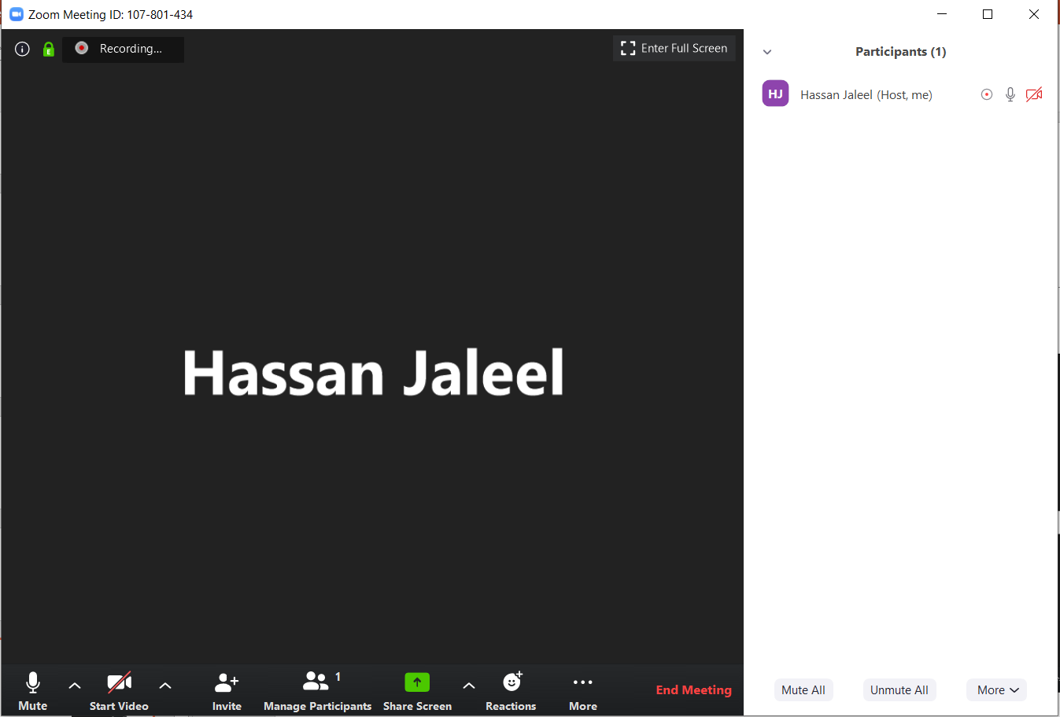
Meeting Recording
The host can also record the meeting
Click on the more tab at the
bottom
There is an option to
Record on this computer
Once recording starts, everyone can
see it on the top left corner of the
window

Slide 9
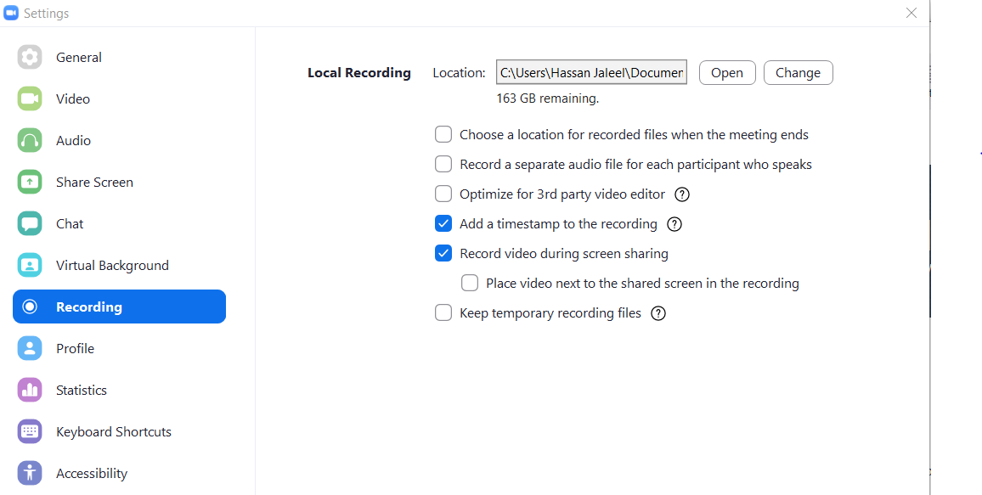
Meeting Recording
Once recording stops and the meeting ends, Zoom formats the video and compresses it.
The resulting video is saved in the \Documents\Zoom
You can change the settings
of video recording from
Settings/Recordings

Slide 10
Synchronous + Asynchronous Lectures
Deliver online lecture by scheduling a meeting on Zoom.
Use screen sharing options for the slides or live demonstration.
Use white board for short notes and scribbling using mouse.
If you have a tablet with stylus, you can write comprehensive notes using white board or any other writing app
Record the live lecture
Upload the lecture on LMS or youtube for students who did not have access to high bandwidth internet.

Slide 11
Demonstration
Here is a link to an online lecture for
EE569: Dynamic Programming and Reinforcement Learning
https://drive.google.com/file/d/1xkpocBRT_LZH30u2pl8eiYN7TEit8yd2/view?usp=sharing
I hosted the meeting through my personal laptop.
Around 12 students attended the lecture.
I also joined the meeting through my IPad pro. and shared the screen of my IPad.
Instructions were given through a writing app in IPad pro.

