Slide 1
_{Brief Intro of Microsoft Teams}
Muhammad Shoaib
Department of Chemistry and Chemical Engineering
Syed Babar Ali School of Science and Engineering (LUMS)

Slide 2
Microsoft Teams
Microsoft Teams is a synchronous teaching platform in which students can see the tutor and slides or white board at the same time. It has a mobile app as well. It also has a stream recording facility so it is possible to use it in asynchronous mode.
Strong point of Microsoft Teams is its integration with Microsoft tools, for example file sharing with OneDrive and SharePoint.
Draw backs of Teams are: its free version can host only 50 students, some people may find its user interface is less friendly compared to Zoom.
It does not have 40 minutes session limit in its free version.
Overall experience is less than ideal on low bandwidth internet.

Slide 3
Strat using Microsoft Teams
Microsoft Teams can be used in browser without any installation. User can login on the link below:
https://products.office.com/en-us/microsoft-teams/group-chat-software
Additional signup is not required, users can login through LUMS id/password or any other hotmail/live/outlook id/password can be used.
For better experience users can download and install its app from the link below. It app is available for Windows/Mac/Linux/Android and iOS.
https://teams.microsoft.com/downloads

Slide 4
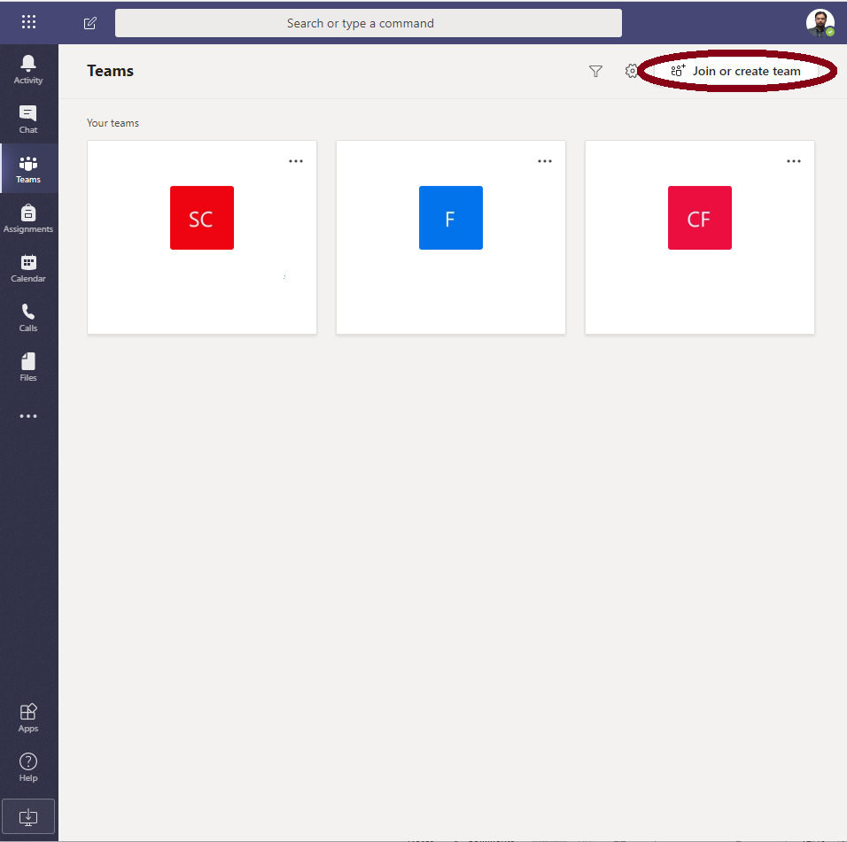
Strat using Microsoft Teams
After successfully logging in users can create (preferably tutors) and/or join (preferably students) teams.
Tutors can create a team and send its invitation link or code to students so that students can join that particular class room (team). More information about creating invitation link/code is available at the link below:
https://support.microsoft.com/en-us/office/create-a-link-or-a-code-for-joining-a-team-11b0de3b-9288-4cb4-bc49-795e7028296f?ui=en-us&rs=en-us&ad=us

Slide 5
Class room environment
In the class room tutor can start with a video conference call and he can share the presentation slides along with video call or white board along with video call. Screenshots of its typical usage scenario is shown below:

Slide 6
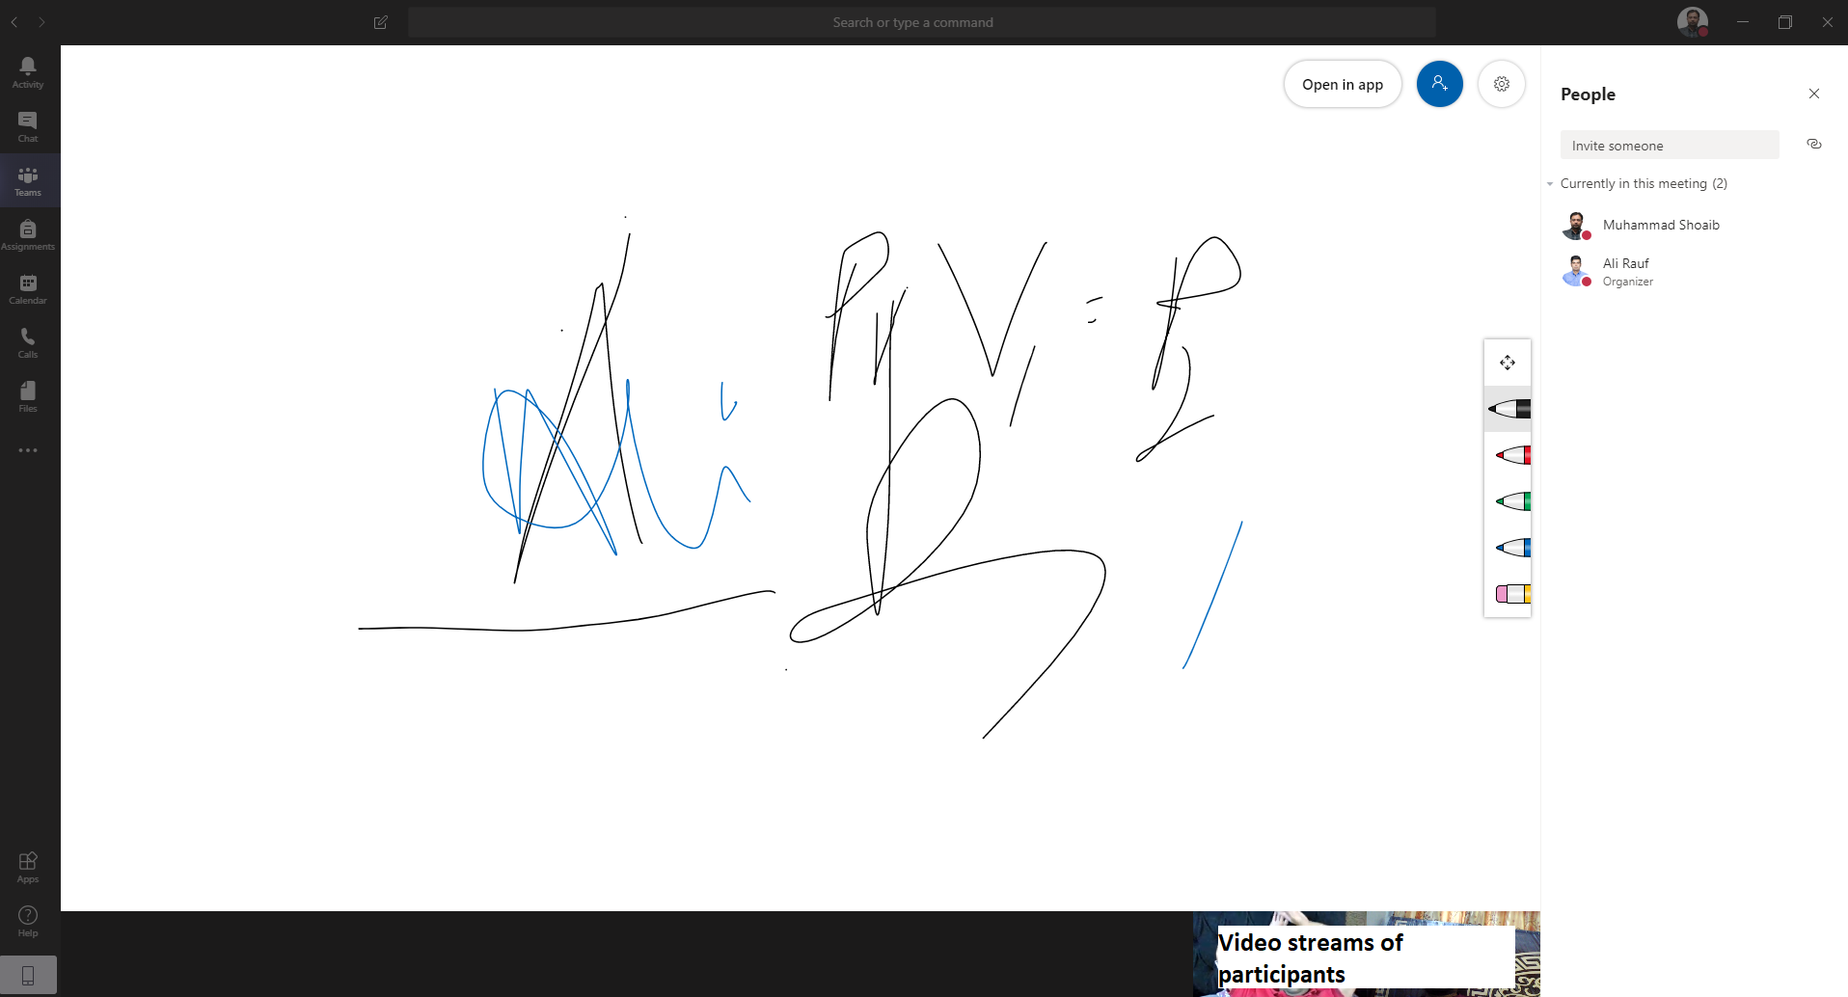
Class room with white board
A built in white board is available in Microsoft Teams. For enhanced experience an additional app Microsoft Whiteboard can be installed from the link below:
https://www.microsoft.com/en-pk/p/microsoft-whiteboard/9mspc6mp8fm4

Slide 7
Integration with other Microsoft Tools
Microsoft teams is fully integrated with Microsoft Office, Outlook, OneDrive and SharePoint.
Tutors can access files present in OneDrive and SharePoint and present these files in classroom.
Nots and other files can be dragged and dropped and these files will be stored in SharePoint in designated folder.
It is possible to chat during class session as well.

